Slide 1
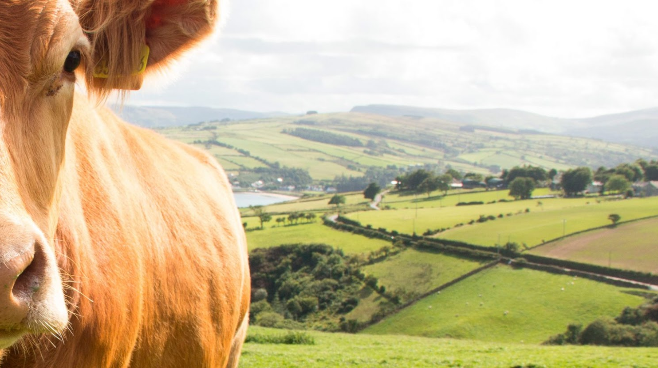

Automatization of livestock health checks with the use of algorithms

Slide 2


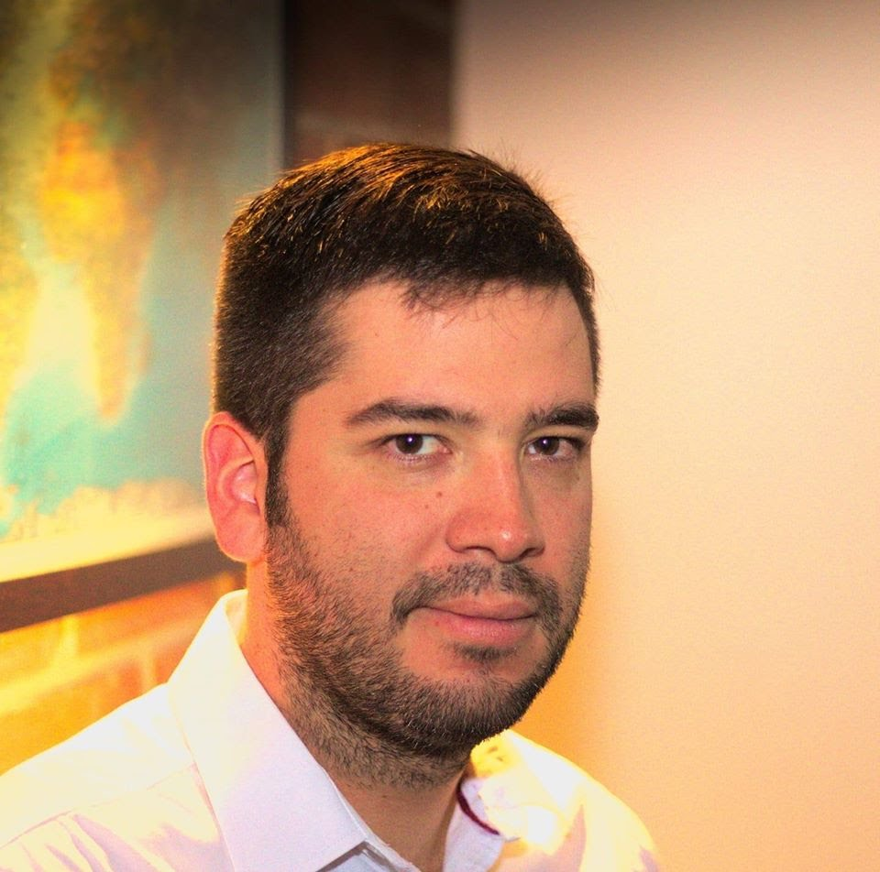



Team Presentation
Julian
Romero
Juan
Avendaño
Simón Marín
Mauricio
Toro
http://github.com/yourUserName/proyecto/...

